Slide 2
About Us
Since its inception in the year 2014; Newlife has always Strived to satisfy the sourcing needs of the Pharmaceutical Industry, where they Exist.
We started our journey with sourcing and supplying of APIs & Bulk drugs to the local Manufacturers during which New Life Medicals has focused on winning the trust & faith of the clients as per the business Ethics.
With an aim to contribute significantly in the Pharmaceutical R&D, we entered in to sourcing and supplying of Reference listed Drugs(RLDs) and Comparator drugs for Clinical Trial Study Across All Therapeutic Segments. Today we have a cluster of satisfied clients and strong Sourcing network of suppliers from US, EU, Canada, Australia, Japan, China, Asia & many more.

Slide 3
Contin…
One of the fastest growing group in span of last 5 years into business of RLDs . Company is currently having the base of customers across the globe with extensive network .
We have US FDA warehouse in US & MHRA approved warehouse in U.K with full GDP compliance and high quality standard team meeting all the regulatory standards.
Our long term vision: We are committed to serve the healthcare industry and will continue to explore new endeavors in future which are in line with the organization’s commitment. Like..
Orphan drug
Finished dosage form
Open for Any new opportunities like Medical device, Nutrition , Intermediates etc..
Our quick and flawless service for Pharma Industries need, better regulatory understanding and strong connection with our suppliers across globe gives us regarded as preferred service provider in the world.

Slide 4
Challenges in Healthcare Industries
Difficult to do proper planning mainly for NCE-1 products where every body are in race to file their dossier to get FTF opportunity
Now a days there are Increasing complexity of Clinical studies
Difficult to meet regulatory requirement
Out of all this mainly it is difficult to find right source , supplying right product as per customer requirement , at right price, at right time & at right place to meet project time lines.

Slide 5
Why We
US FDA approved warehouse for distribution and storage of Pharmaceutical products
MHRA & GDP approved warehouse based in U.K for distribution and storage of Pharmaceutical products
Secured, Authentic & reliable sourcing partner for RLDs complying all local and international regulatory guidelines
Expertise in REMs, Hospital line, specialty line, Clinical Trial Supply & “difficult to source” product
Customer centric approach & Competitive prices
Amongst the top 3 suppliers RLD suppliers in top 3 as per Sept 2020 Import data in India.
Provides you services with the best-dated products, sequential lots, preferred lot, documentation / pedigree as per customer needs
Quick & Flawless service to meet Critical time line of project when it comes to comparator drugs

Slide 6
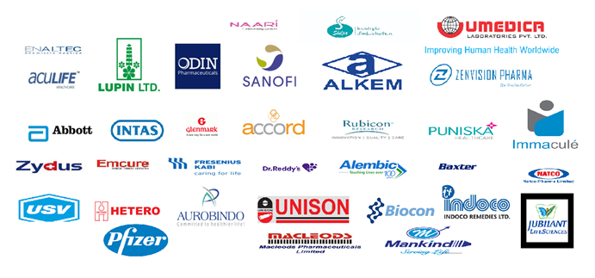
Clientele List

Slide 7
Difficult Line Access
Avastine
Calquence
Caelyx
Entereg
Firazyr
Herceptin
Ingrezza
Invega
Kalydeco
Lucentis
Mabthera
Neplazid
Neulasta
Neptera
Ocaliva
Ofev
Orkambi
Revlimid
Tarceva
Tecfidera
Tracleer
Sabril
Sutent
And many more…

Slide 8
We also offer
API sourcing:
Human
Veterinary
Global Finish formulation
Orphan drugs

Slide 9
Client Base
USA
Europe
Australia
Canada
Dubai
China
Japan
Asia

Slide 10
Contacts
USA:
NewLife Medicals LLC
705, Montgomery Avenue, Suite 210,
Pennvalley, PA 19072-2011
INDIA:
426, 4th floor, Yash Arian,
Gurukul Road, Memnagar,
Ahmedabad-380052, Gujarat, India
For RLDs/API’s/FF requirements: Mr. Ankit Shah
ankit@newlifemedicals.com/prachi@newlifemedicals.com/rld@newlifemedicals.com
India. +919898255874
US .: + 1 610-615-1483

Slide 11
Thank You

